Slide 1
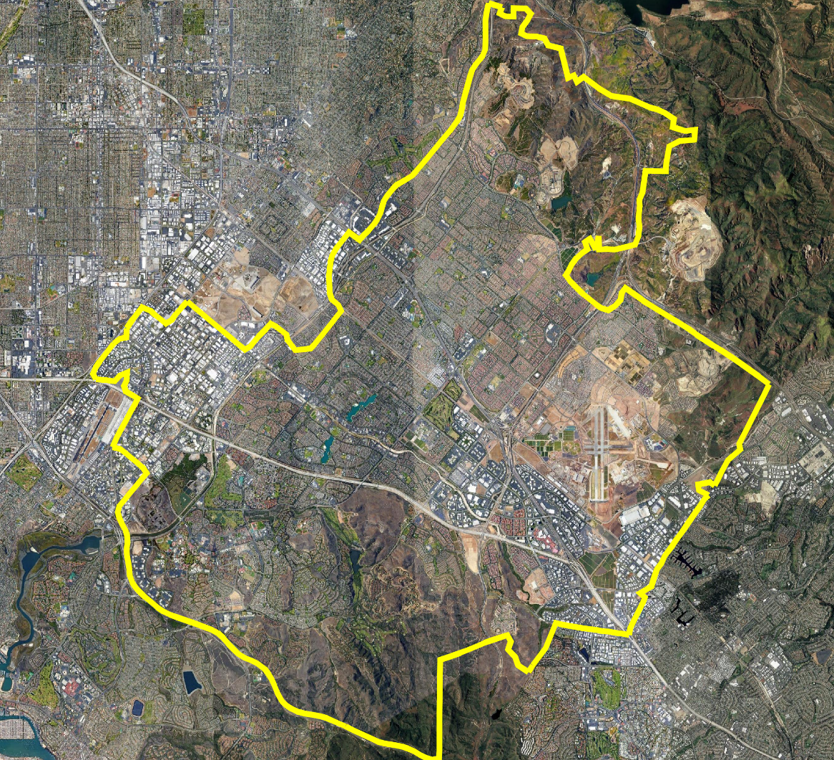
City of Irvine
Community Workshops
Dr. Justin Levitt
National Demographics Corporation

Slide 2
Introductions

Slide 3
Today’s Goals
You Learn from the Experts
Experts Listen to You
Mapping Tools Overview
You Leave Empowered to Give Effective Feedback

Slide 4
Why You Should Care
Democracy works better when people are engaged
You are the experts on your community
You are the expert on your neighborhood
The districts determined in this process will be around until 2031

Slide 5
Today’s Schedule
10 - 11:30 a.m.
Process, Rules and Goals
Mapping Tools
Neighborhoods / Communities of Interest
Next Steps

Slide 6


Proposed Charter Reforms
The Council is placing a Charter amendment on the March 2024 ballot that would:
  Increase the size of the City Council from five members to seven
  Six of the seven seats would be elected “by district”
  The Mayor would continue to be elected at-large

Slide 7
Election Systems
“At Large”
“From District” or “Residence” Districts
  Very rare; subject to CVRA challenge
“By District”

Slide 8
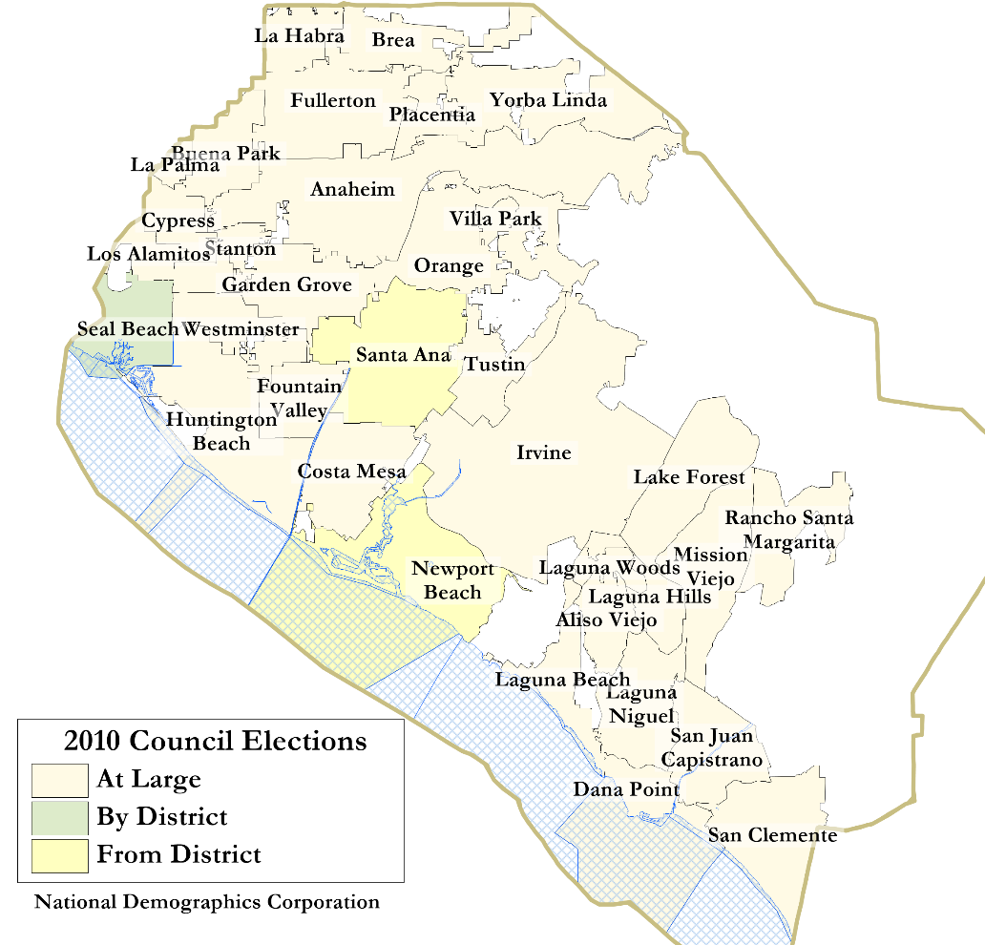
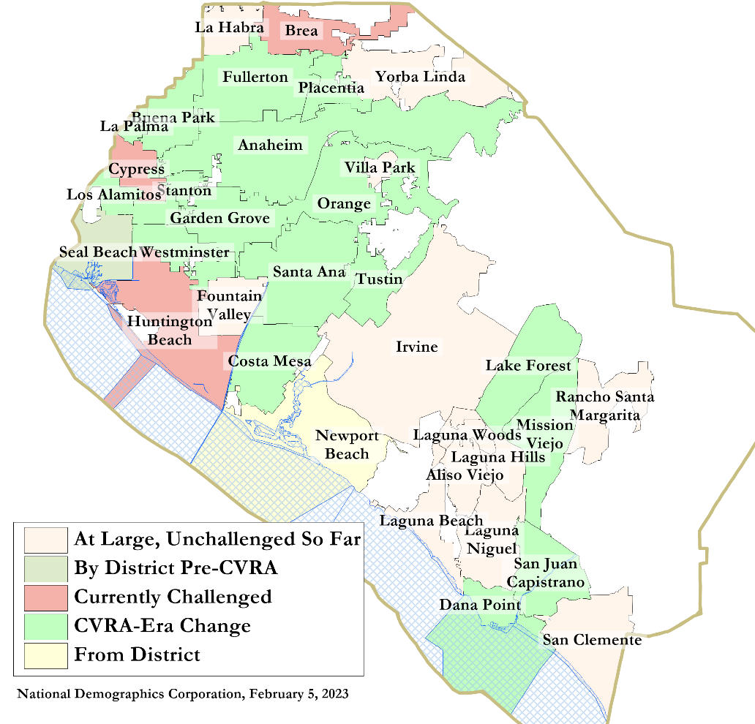
By-District Elections
2010
2023
Statewide switched since 2002:
  At least 275 school districts, 36 Community College Districts, 177 cities, 1 County, and 53 special districts.

Slide 9
Districting Process Overview
Step | Description
Two Initial Hearings April 11 & May 9 | Held prior to release of draft maps. Education and to solicit input on the composition of districts.
First round of Workshops April 15 – May 27 | Held throughout the community prior to release of draft maps. Education and to solicit input on the composition of districts.
Map Submission deadline June 29 | Deadline for public map submissions to ensure the map can be presented and discussed at the third public hearing.
Release draft maps July 4 | Maps must be posted at least 7 days prior to 3rd hearing.
Two hearings on draft maps July 11 & Sept 12 | Two meetings to discuss and revise the draft maps and to discuss the election sequence.
Second round of Workshops July – September (TBA) | Additional workshops held throughout the city to discuss the draft maps.
Map selection October 10 | Map adopted either before or after vote on charter change. Final map must be posted at least 7 days prior to adoption.
Charter Vote Citywide vote in March 2024 | Charter changes put to the voters in the statewide March primary.
First By-District Election November 2024 | First by-district Council elections held.

Slide 10
Workshops – First Round
Date & Time | Location
Saturday, April 15 10 am | City Council Chamber, 1 Civic Center Plaza
Saturday, April 15 2 pm | Great Park Artist Studio, 8000 Great Park Blvd
Saturday, April 22 10 am | Quail Hill Community Center, 39 Shady Canyon Dr
Saturday, April 22 2 pm | Heritage Park Library, 14361 Yale Ave
Wednesday, April 26 6 pm | Virtual forum over Zoom
Saturday, May 13 3 pm | South Coast Chinese Cultural Center, 9 Truman St
Saturday, May 27 10 am | Lakeview Senior Center, 20 Lake Rd

Slide 11

Districting Rules and Goals
1. Federal Laws
2. California Criteria for
Cities
3. Other Traditional Districting Principles
Equal Population
Federal Voting Rights Act
No Racial Gerrymandering
Geographically contiguous
Undivided neighborhoods and “communities of interest”
(Socio-economic geographic areas that should be kept together)
Easily identifiable boundaries
Compact
(Do not bypass one group of people to get to a more distant group of people)
Prohibited:
“Shall not favor or discriminate against a political party.”
Respect voters’ choices / continuity in office
Future population growth

Slide 12
Demographic Summary
Each of six districts would contain about 51,326 people.

Slide 13
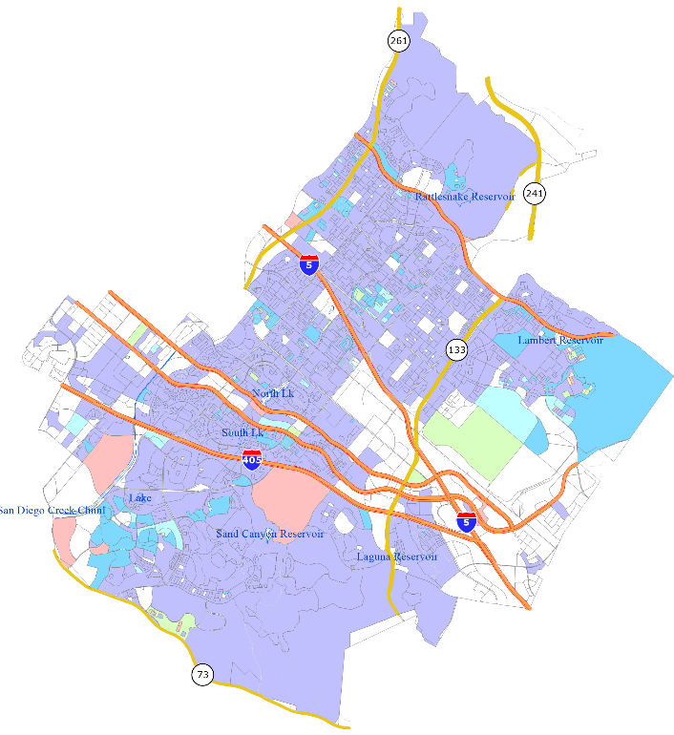
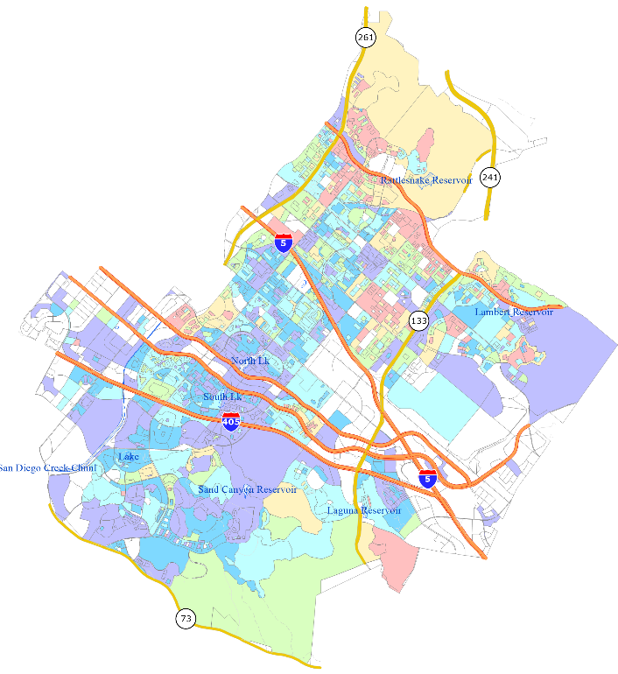
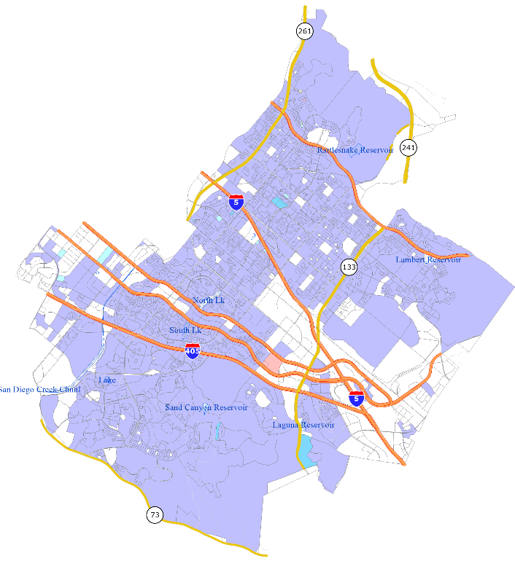
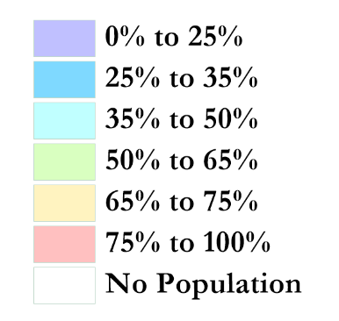
Protected Class CVAP
Latino
Asian-American
African-American

Slide 14

Defining Neighborhoods
1st Question: What is your neighborhood?
2nd Question: What are its geographic boundaries?
Examples of physical features defining a neighborhood boundary:
Natural neighborhood dividing lines, such as highway or major roads, rivers, canals and/or hills
Areas around parks or schools
Other neighborhood landmarks
In the absence of public testimony, planning records and other similar documents may provide definition.

Slide 15
Beyond Neighborhoods:
Defining Communities of Interest
1st Question: What defines your community?
Geographic Area, plus
Shared issue or characteristic
  Shared social or economic interest
  Impacted by city policies
Tell us “your community’s story”
2nd Question: Would this community benefit from being “included within a single district for purposes of its effective and fair representation”?
Or would it benefit more from having multiple representatives?
Definitions of Communities of Interest may not include relationships with political parties, incumbents, or political candidates.

Slide 16
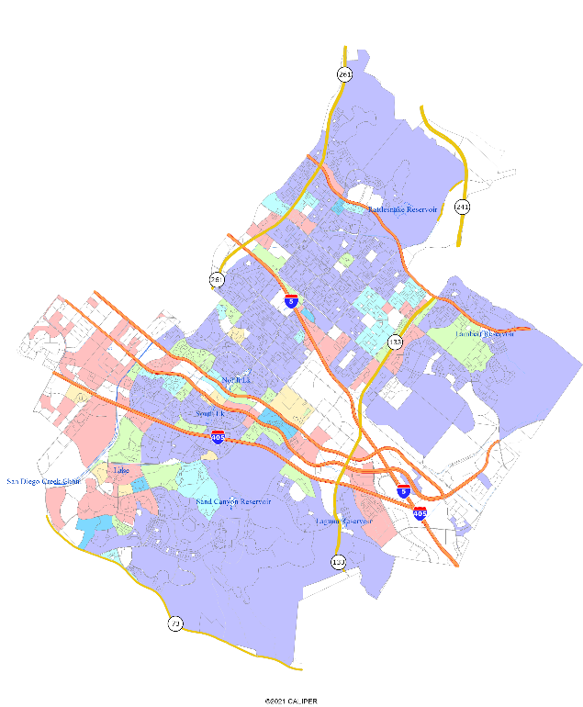
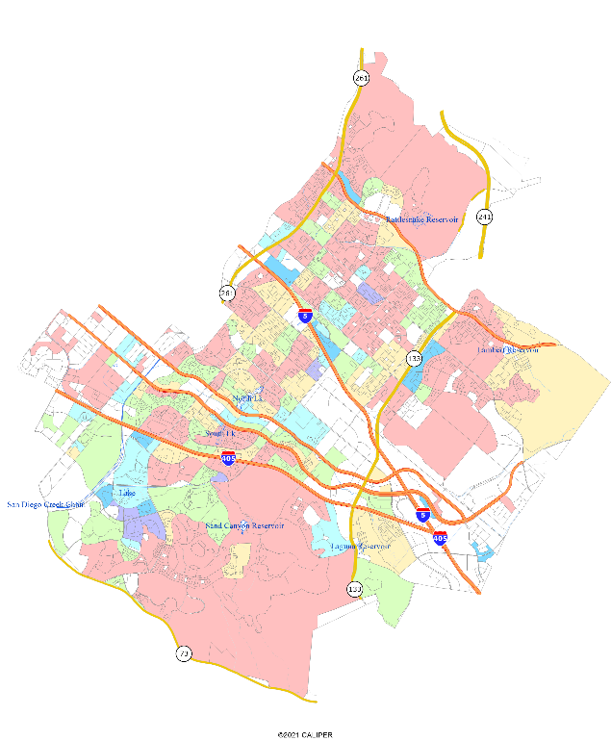
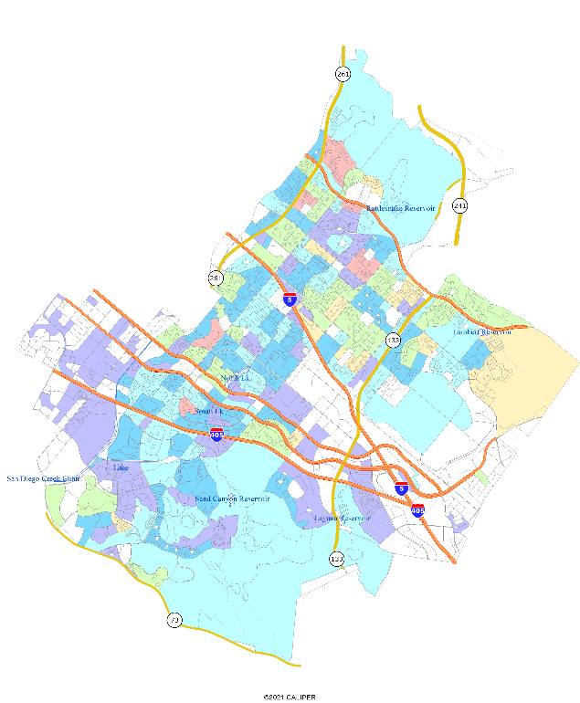
Demographics and communities
Multi-family housing
Income over $75k
Child at home

Slide 17
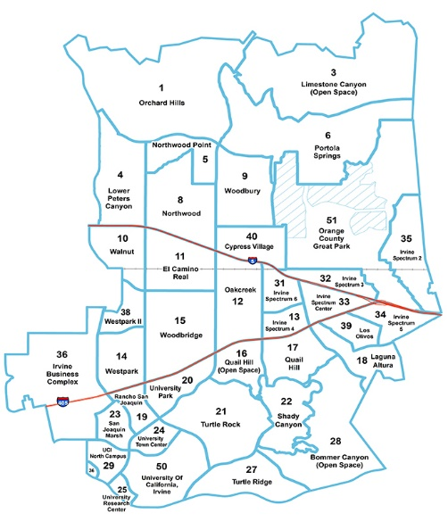
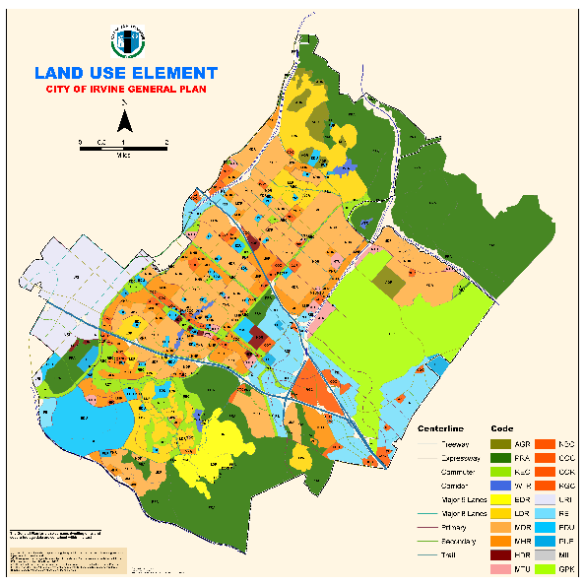
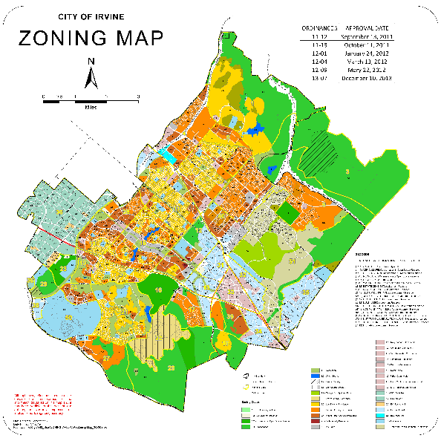
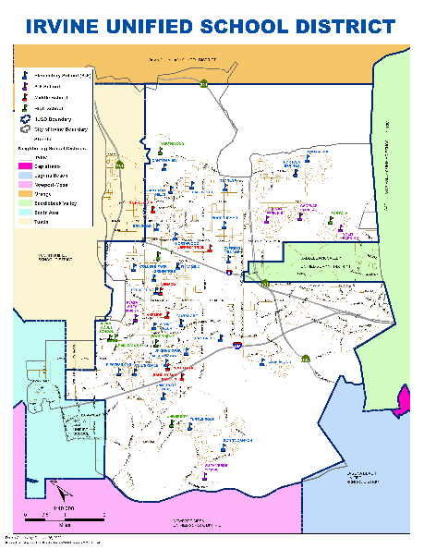
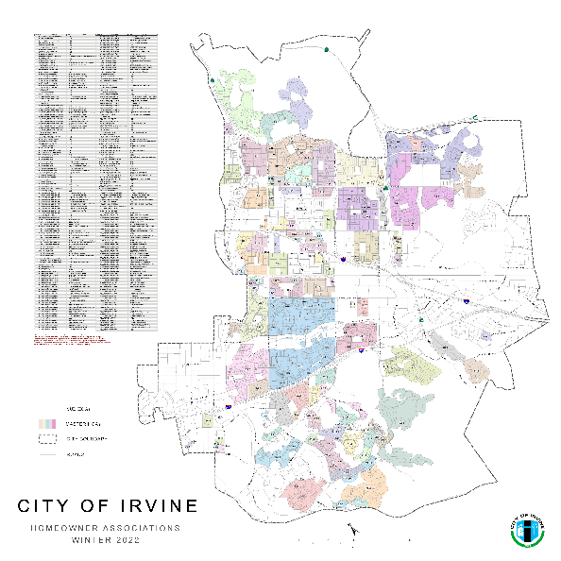
Possible Neighborhoods / Communities
Planning Areas
Home Owner Associations

Slide 18
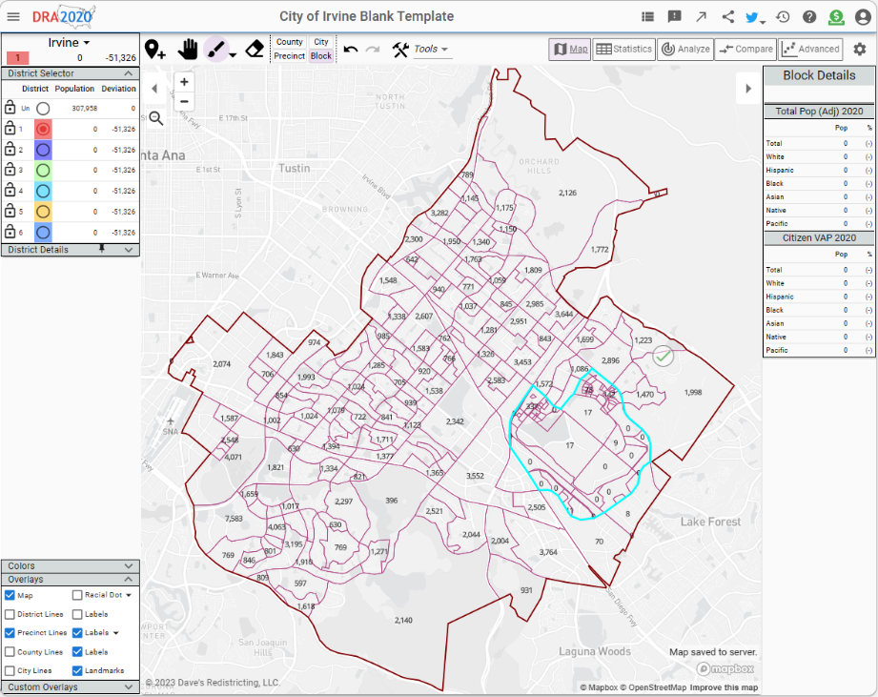
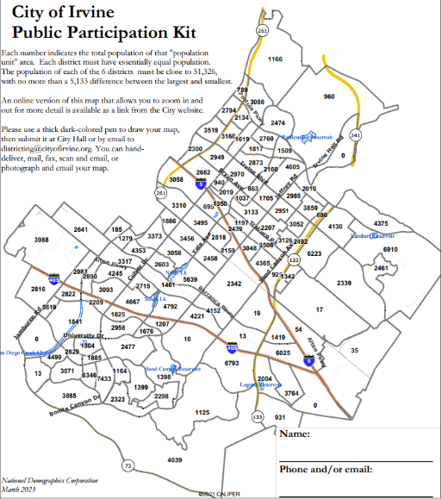
Public Mapping and Map Review Tools
Different tools for different purposes
Different tools for different levels of technical skill and interest
  Simple “review draft maps” tool
  Paper-based simple “Draw a draft map” tools
  Powerful, data-rich “Draw a draft map” online tool

Slide 19
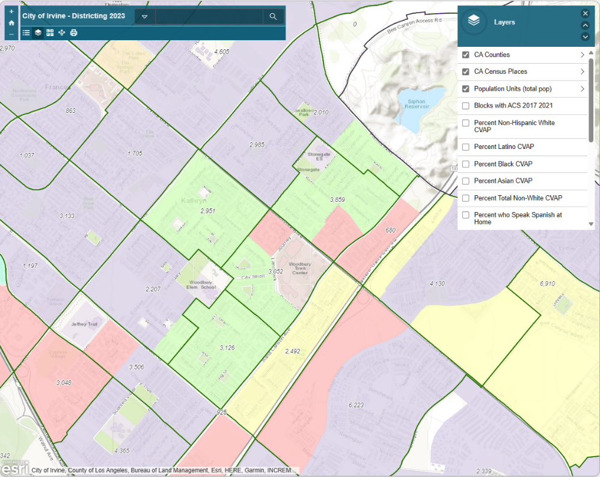
Simple Viewing Tool
Very similar to Google Maps:
Zoom in and out, or enter an address to see which district it is in
Choose which overlays you wish to add (if any)
Maps will be posted here when available

Slide 20

Simple Map Drawing Tool
Paper “Public Participation Kit”
For those without internet access or who prefer paper
Total Population Counts only – no demographic numbers

Slide 21
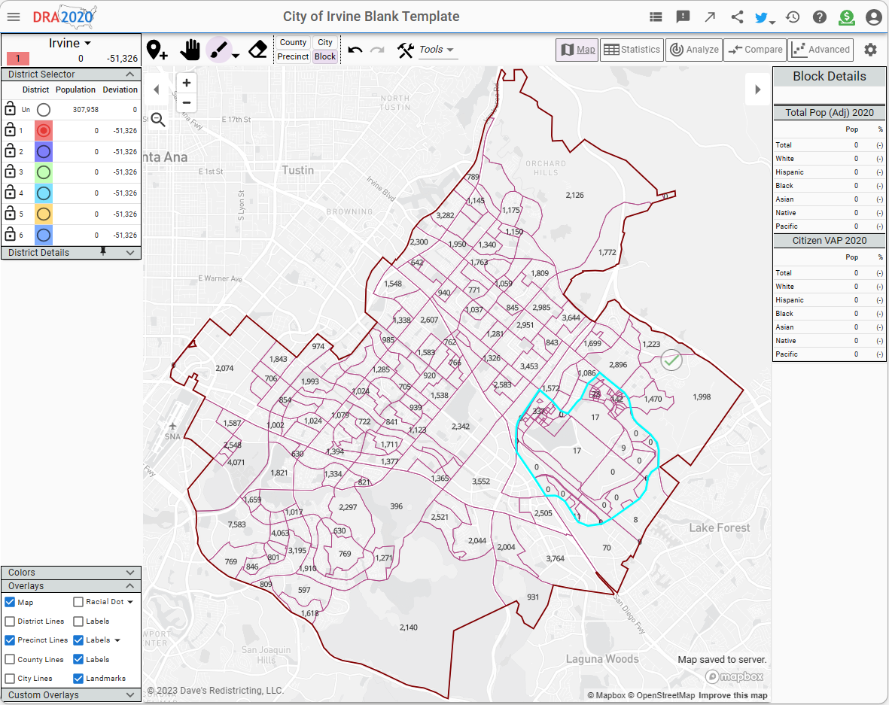
Dave’s Redistricting App (DRA)
Draw Your Community of Interest or a Full District Map
Also includes simple district-mapping tool
Email a link to your map to the City

Slide 22
Q&A With Your Hosts

Slide 23
Your Turn – Communities of Interest
Who is part of your community?
What are some meaningful places your community recognizes or gathers at?
What are some common concerns you share with a group?
What are some common cultural characteristics that unite a community?
What are common work-related traits that bring a community together?
What is significant about the physical environment?
What areas benefit from staying together in a district?
Your thoughts will become part of the record.

Slide 24
Upcoming Workshops
Date & Time | Location
Saturday, April 22 2 pm | Heritage Park Library, 14361 Yale Ave
Wednesday, April 26 6 pm | Virtual forum over Zoom
Saturday, May 13 3 pm | South Coast Chinese Cultural Center, 9 Truman St
Saturday, May 27 2 pm | Lakeview Senior Center, 20 Lake Rd

Slide 25
Share Your Thoughts
Website
DrawIrvine.org
Phone
949-724-7575
Email
districting@cityofirvine.org

